Slide 1

PREDICTIVE ANALYSIS
GROUP PROJECT
CONAGRA BRAND SALES ANALYSIS
Presented by: Group-5

Slide 2
RESEARCH QUESTION
Are there price gaps and/or price thresholds that cause an unexpected impact on sales and/or velocities?
How does socio-economic characteristic of the population affect the market share.
Should Conagra have varying merchandising strategies by brand or market? Any segments that respond better to merchandising activity?

Slide 3
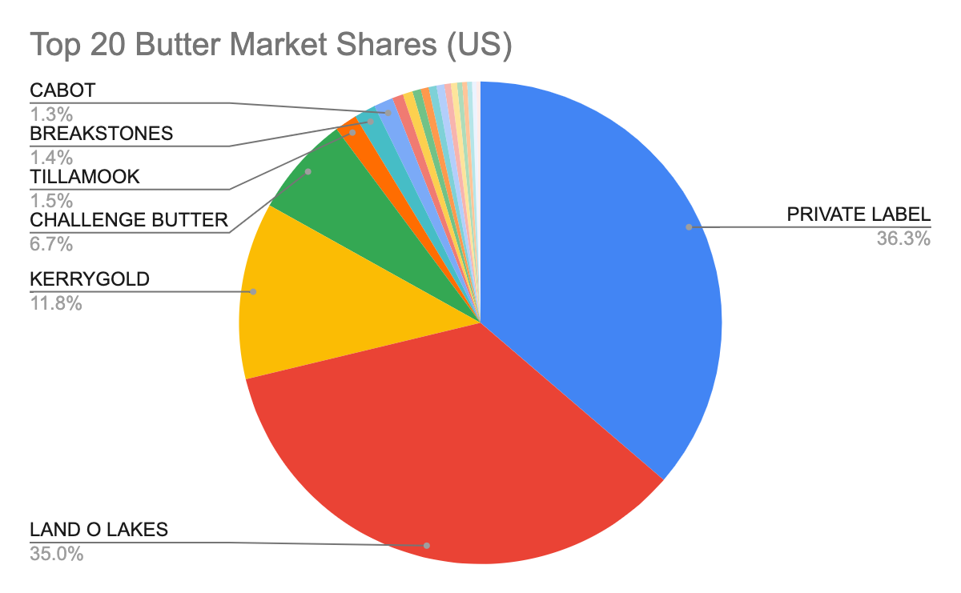
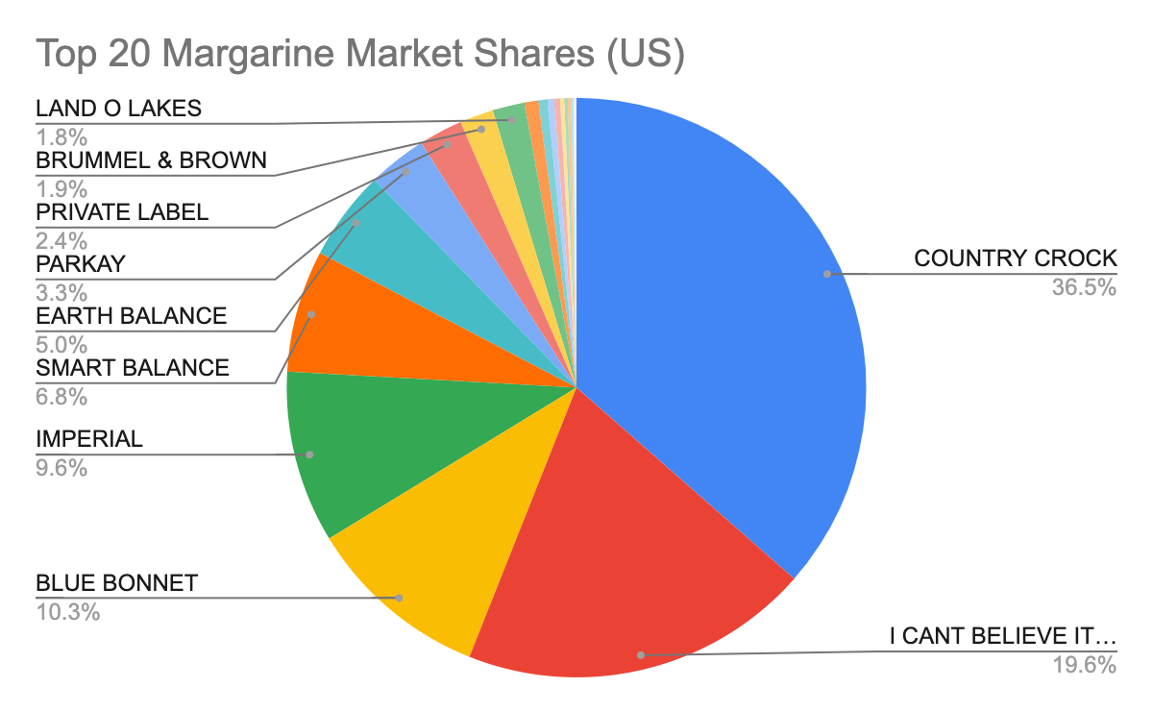
TOP -20 BRANDS
2
Notes:
Studying the above top 20 brands in both Butter and Margarine category, our analysis revealed that none of the Conagra brands were present in the top 20 butter brands, prompting us to focus on margarine.
The Conagra brands that we have analyzed in this are Blue Bonnet, Smart Balance, Earth Balance, and Parkay.

Slide 4
ANALYSIS METHODOLOGY
Identifying the top product categories in each region and the top brands within each product.
Analyzing Conagra brands through pairwise comparisons with similar leading brands in each region based on market share and pricing points.
Analyzing demographic data for the top 20 margarine brands on a national level to identify segments where Conagra can compete and increase their market shares.
2

Slide 5
HIGHEST SOLD PRODUCT CATEGORIES
Market Share (%age)
REGION
2
Notes:
We identified 3 product categories under margarine that are sold the most in all the 8 regions that Conagra operates in as namely Tubs 15oz, Tubs 45oz, and Sticks 16oz, as shown in Table 1 (in appendix).
We could clearly see that margarine generates the most revenue in the form of tubs in the form 15 Oz and 45 Oz volumes (combined ~60%) across all regions, with sticks in 16 Oz being a close 3rd (~13%). So, this should be the focus area for Conagra to increase its market share.

Slide 6
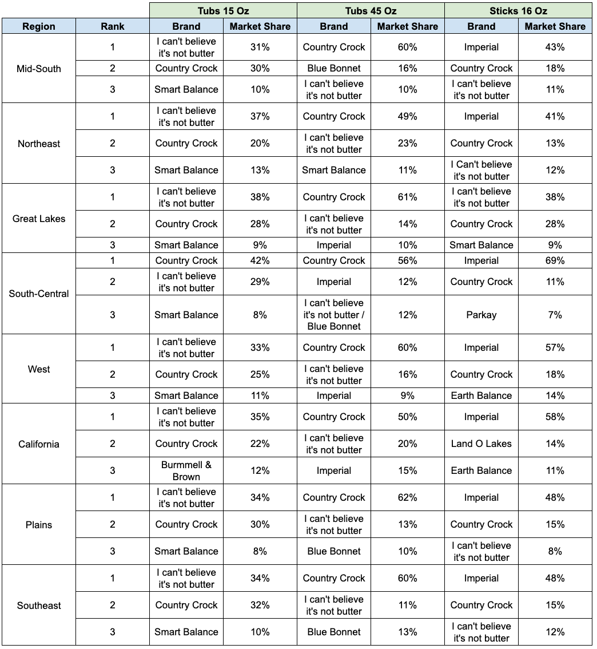
TOP BRANDS AS PER REGION (PRODUCT CATEGORY)
Tubs 15 OZ
I Can’t Believe Its Not Butter
Country Crock
Tubs 45 OZ
Imperial
Country Crock
Sticks 16 OZ
I Can’t Believe Its Not Butter
Smart Balance
Country Crock
Blue Bonnet
I Can’t Believe Its Not Butter
Imperial
2

Slide 7
PRICE THRESHOLDS WITH MAXIMUM IMPACT ON SALES (TUBS 15 OZ)
Sales– 33%
Price- $8 to $7
Northeast
Plains
West
94
Sales– 33%
Price- $8 to $7
Great Lakes
Sales– 30%
Price- $8 to $7
Sales– 42%
Price- $8.5 to $7
California
Mid South
Sales– 30%
Price- $7.5 to $6.5
Sales– 50%
Price- $8.5 to $6.5
South Central
Southeast
Sales– 42%
Price- $8 to $7
Sales– 30%
Price- $7.5 to $6.5
8
Source: IRI POS, Total US MULO+C, 52Wks Data Ending 02.28.21

Slide 8
PRICE THRESHOLDS WITH MAXIMUM IMPACT ON SALES (TUBS 45 OZ)
Sales– 42%
Price- $4.5 to $3.5
Northeast
Plains
West
94
Sales– 30%
Price- $5 to $4
Great Lakes
Sales– 45%
Price- $4.5 to $3.5
California
Sales– 45%
Price- $4.5 to $3.5
Mid South
Sales– 73%
Price- $4 to $2.5
Sales– 40%
Price- $4.5 to $3.5
South Central
Southeast
Sales– 39%
Price- $5 to $4
Sales– 37%
Price- $4.5 to $3.5
9
Source: IRI POS, Total US MULO+C, 52Wks Data Ending 02.28.21

Slide 9
PRICE THRESHOLDS WITH MAXIMUM IMPACT ON SALES (STICKS 16 OZ)
Sales– 43%
Price- $3 to $2
Northeast
Plains
West
94
Sales– 35%
Price- $3.5 to $2.5
Great Lakes
Sales– 44%
Price- $3.5 to $2.5
California
Sales– 34%
Price- $3.5 to $2.5
Mid South
Sales– 33%
Price- $3.5 to $2.5
Sales– 51%
Price- $3.5 to $2.5
South Central
Southeast
Sales– 48%
Price- $3.5 to $2.5
Sales– 34%
Price- $3.5 to 2.5
10
Source: IRI POS, Total US MULO+C, 52Wks Data Ending 02.28.21

Slide 10
TOP NON-CAG BRANDS VS CAG BRANDS
Based on evaluation over market share and median prices, we figured our some similar NON-CAG brands to carry out a comparative Analysis with a CAG brand.
Given the remaining Conagra brand, Earth Balance, is sold at a very high price point, we weren’t able to find any direct competitors on a national level. And in every local market, Earth Balance ended up capturing maximum market share in the high price bucket segment
Smart Balance
&
I can’t believe its not butter
Blue Bonnet
&
Imperial
Parkay
&
Fleischmanns

Slide 11
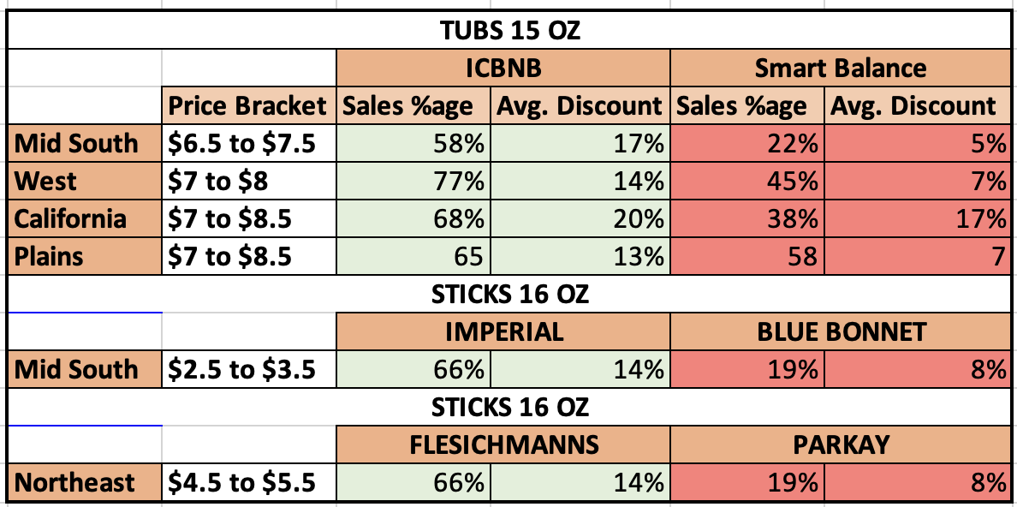
SALES GAP ANALYSIS

Slide 12
INSIGHTS FROM DEMOGRAPHIC ANALYSIS
Presence of Blue Bonnet is 9% less than Imperial in County Size A Top 25 Markets.
I can't believe its not butter is 5% more preferred by Males of Graduated high school over Smart Balance.
I can't believe its not butter is 5% more preferred by Pet Owners over Smart Balance.
Females in the age range from 25 – 34 year prefer Country Crock by 9% more over Parkay.
Country Crock is catering 8% more market share for the parents having more than one children over Parkay.
7% of the 35–44-year-old men prefer to buy Country Crock over Parkay
7% of the men working for 35 hours per week prefer to buy Country Crock over Parkay.
6% of the Milennials prefer to buy Country Crock over Parkay.
6% of the females working in white collar job buys Country Crock over Parkay

Slide 13
OVERALL RECOMMENDATIONS
Invest in targeted marketing campaigns
Develop promotions that appeal to specific demographics:
Partner with companies or organizations
Highlight unique selling points:
Notes:
Invest in targeted marketing campaigns: Conagra could benefit from investing in advertising and promotional campaigns that are specifically targeted towards key demographics that each brand is struggling to reach. For example, Blue Bonnet could focus on advertising in larger urban areas, while Smart Balance could create campaigns targeted towards individuals with higher levels of education.
Develop promotions that appeal to specific demographics: In addition to marketing campaigns, Conagra could consider developing promotions that are tailored towards specific demographic groups. For example, Blue Bonnet could create kid-friendly packaging or promotions for families with children, while Smart Balance could market themselves as a more affordable alternative to I Can't Believe It's Not Butter.
Highlight unique selling points: Each brand has its unique selling points, such as Smart Balance's appeal to pet owners or Blue Bonnet's potential for new flavors or product formulations popular among Hispanic consumers. Conagra could benefit from highlighting these unique selling points in their marketing and advertising campaigns to differentiate their brands from competitors.
Partner with companies or organizations: As seen in the recommendation for Parkay, Conagra could consider partnering with companies or organizations that employ or cater to specific demographic groups as a way to increase brand awareness and loyalty among those groups. This could include offering discounts or promotions to employees or customers of these companies.

Slide 14
RECOMMENDATIONS (BLUE BONNET V/S IMPERIAL)
County Size A Top 25 Mkts
Target Race - Other / Unknown
Target Acculturated Hispanic
Target Child - 1+:
Notes:
County Size A Top 25 Mkts: Blue Bonnet performs lower in the top 25 markets compared to Imperial. This suggests that Blue Bonnet may have a weaker presence in larger urban areas. To capitalize on this, Blue Bonnet could consider investing in advertising and promotional campaigns that target consumers in these markets. This could include local TV and radio ads, billboards, and social media campaigns that highlight the brand's strengths and unique selling points.
Target Race - Other / Unknown: Blue Bonnet has a lower market share among consumers who identify as "Other/Unknown" race compared to Imperial. This presents an opportunity for Blue Bonnet to improve its outreach to these consumers, potentially through targeted marketing initiatives that appeal to the unique needs and preferences of this demographic.
Target Child - 1+: Blue Bonnet and Imperial have similar market shares among households with one or more children. However, given that this is a relatively large segment, Blue Bonnet could consider developing products and promotions that specifically target families with children. For example, the brand could create a kid-friendly packaging design, or offer promotions that include free or discounted items for children.
Target Acculturated Hispanic: Blue Bonnet performs less well among acculturated Hispanic consumers compared to Imperial. This suggests that Blue Bonnet could benefit from developing products or marketing initiatives that appeal specifically to this demographic. This could include creating new flavors or product formulations that are popular among Hispanic consumers, or partnering with Hispanic-focused media outlets to increase brand awareness and recognition.

Slide 15
RECOMMENDATIONS (SMART BALANCE V/S ICBINB)
Target Higher Education
Target Pet Owner
Target Larger Household Size
Target Generation X
Target Lower Income
Notes:
Target Higher Education: Smart Balance performs better among males and females who have graduated high school and some college. This suggests that marketing campaigns and product promotions could be targeted towards individuals with higher levels of education to capture their attention.
Target Pet Owners: Smart Balance has a relatively high percentage of pet owners.. This could be used in marketing and advertising to appeal to pet owners and highlight how their product is a better choice for those who care about their pets.
Target Generation X: Smart Balance performs well among Generation X, women aged 45-54, and established workers with no children. Therefore, these groups can be targeted for promotions and advertising campaigns.
Target Larger Household size: Smart Balance performs well among 5+ person households, which suggests that their products may be more appealing to larger families. Promotions and advertising campaigns targeting larger households could be developed to capitalize on this demographic.
Target Lower- Income: Smart Balance performs better among lower-income individuals ($25-34.9K). This suggests that they could market their products as a more affordable alternative to I Can't Believe It's Not Butter.

Slide 16
RECOMMENDATIONS (PARKAY V/S COUNTRY CROCK)
Target Females: 25-34 year old
Target Household With Children
Target Males 35-44
Highlight Product with Children
Target Employed Male
Notes:
Target Females 25-34: Parkay seems to perform relatively worse than Country Crock with female consumers aged 25-34 years old, with a 9% competition gap. One recommendation for Parkay could be to target this demographic further with marketing campaigns and product promotions that are tailored towards their preferences and needs.
Target Households with Children: Both brands seem to be performing equally well among households with one or more children, with Country Crock ahead by 8%. Parkay can try to improve their marketing strategies to target families with children better. This can include promoting their product's health benefits, convenience, or affordability for families.
Highlight Products for Children: Parkay seems to lag behind Country Crock among young families with children under 12 years old, with a 8% competition disadvantage. A possible recommendation for Parkay could be to develop new product lines that appeal to this demographic, such as offering a range of spreads with flavors that appeal to children, or highlighting their product's nutritional benefits for young children.
Target Males ages 35-44: Male consumers aged 35-44 years old seem to prefer Country Crock over Parkay, with a 7% competition disadvantage. To capture more of this market, Parkay can focus on developing a strong brand identity and promotional campaigns that appeal to this demographic. For instance, highlighting their product's quality, value, or convenience for busy males.
Target Employed Males: Lastly, Parkay seems to have a weaker presence among employed males working over 35 hours per week, with a 7% competition gap. To leverage this competitive edge, Parkay could consider partnering with companies or organizations that employ this demographic and offering discounts or promotions as a way to increase brand awareness and loyalty among this group.

Slide 17
THANK-YOU!

